Slide 1
Chapter : Architecture Patterns

Slide 2
Types of Architecture Styles
Categories | Architecture Styles
Data Centered | Blackboard and Repository
Interaction Oriented | MVC and PAC
Communication Oriented | Peer-Peer and Publish-Subscriber
Deployment Oriented | Layered – Client / server, 3 Tier and Distributed

Slide 3

Client-Server
Notes:
The most common
Client process: issues a request to server process
Server process Accept the request and process it then send the data to client process

Slide 4
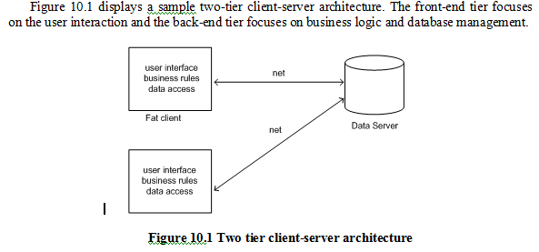
Notes:
This is the first client-server architecture
Data are in server machine and requested by client

Slide 5
Client-Server architecture
The application is modeled as a set of services that are provided by servers and a set of clients that use these services.
Clients know of servers but servers need not know of clients.
Clients and servers are logical processes.
Examples: email exchange, web access, database access
Notes:
What the application does? The application is modeled as a set of services that are provided by servers and a set of clients that use these services

Slide 6
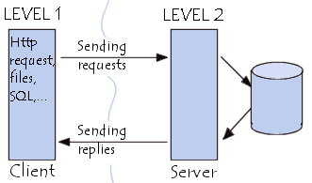
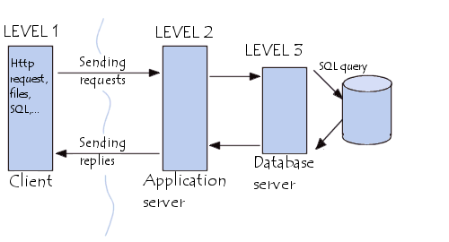
Client-server architectures: Types
There are basically two types of client-server architectures
  Two tier architectures
  Three tier architectures
Notes:
Also there is multi-tier architecture

Slide 7
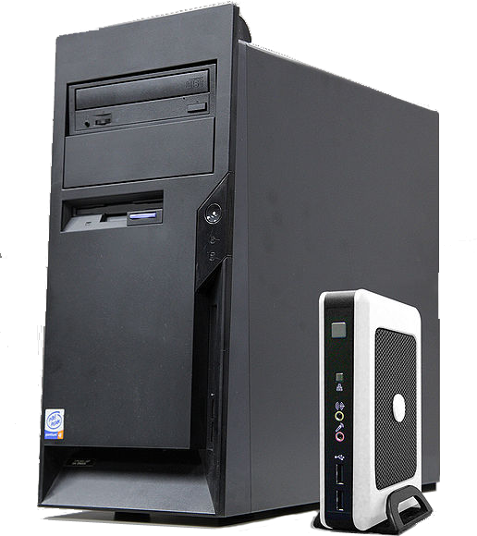
Types of Two Tier Model - Thin and fat clients
Thin-client model (also called Slim-Client)
  In a thin-client model, all of the application processing and data management is carried out on the server. The client is simply responsible for running the presentation software.
Fat-client model (Thick-Client)
  In this model, the server is only responsible for data management. The software on the client implements the application logic and the interactions with the system user.
Notes:
-Thin-client model : for example psu students devices can’t install any program.. All done on server
-Fat-client model: all processes on client.. Only data are on server

Slide 8
Thin and fat clients

Slide 9
Three tier architecture
3-tier architectures attempt to overcome some of the limitations of the 2-tier architecture by separating presentation, processing, and data into 3 separate and distinct entities.
Notes:
Many distributed system use 3 tier

Slide 10
Tier Architecture
Pros
  Maintainability
    Because each tier is independent of the other tiers, updates or changes can be carried out without affecting the application as a whole.
  Scalability.
    Because tiers are based on the deployment of layers, scaling out an application is reasonably straightforward.
  Availability.
    Applications can exploit the modular architecture of enabling systems using easily scalable components, which increases availability.
Cons
  Tightly coupled to language
  Lack extensibility
  Lack transparency
Notes:
Maintainability: We can update, change ..
Scalability: we can add, not restricted, al computers can be managed by IT team
Availability: always available also backup in emergency
Lack extensibility: how much machine capacity
Lack transparency: we don’t know what server we are connecting

Slide 11
Broker Architectural Style
The broker architecture is a middleware architecture used in distributed computing to coordinate and facilitate communication between registered servers and clients.
Bushmann et al. developed the broker architectural pattern to design a distributed system into components that interact by remote service invocations.
“The Broker architectural pattern can be used to structure distributed software systems with decoupled components that interact by remote service invocations.
A broker component is responsible for coordinating communication, such as forwarding requests, as well as for transmitting results and exceptions.” (Bushmann et al, 1996).
Notes:
The web is distributed ..
Broker:
Intrnet .. Connect with remote server/client..all the components interact by remote service

Slide 12
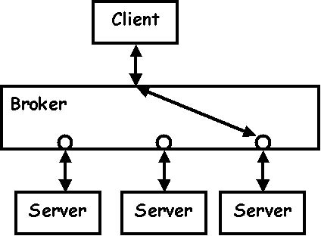
Broker Architecture
based on client/server concepts but Transparently distribute the software system to different nodes
Server make their service available to client by registering and publishing their interface to brokers
Clients request the services of server from broker by lookup
    Client can make of a service without knowing where the location of a server.
Notes:
We don’t need to know the location of the server
CORBA- advance java

Slide 13
A broker component is responsible for coordinating communications –
brokering the service requests,
locating a proper server,
forwarding and dispatching requests, and
sending responses or exceptions back to clients.
Actually, a broker can be either an invocation-oriented service, to which clients send invocation requests for brokering, or a document or message- oriented broker to which clients send a message (such as an XML document).
Notes:
locating a proper server, (broadcasting, then only the proper server will respond)

Slide 14
A broker acts as a policeman in a busy intersection who controls and interacts with the client components and server components.
The connection between clients and servers is maintained by the broker.
CORBA (Common Object Request Broker Architecture) is a good implementation example of the broker architecture.
Notes:
CORBA: is an example of broker archeticture

Slide 15
With the broker pattern, a distributed client can access distributed services simply by calling a remote method of a remote object just as if it were a local method call.
This concept is similar to Remote Procedure Call (RPC) in Unix distributed structured programming and Remote Method Invocation (RMI) in Java distributed object-oriented programming.
The distributed clients only need to obtain a reference to the appropriate object, instead of writing detailed code for protocol-oriented communication.

Slide 16
Figure 10.3 Broker model
Notes:
Simple broker model

Slide 17
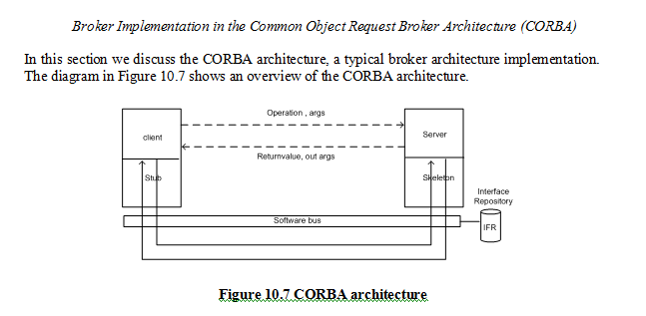
Notes:
Server is smiliar to stub

Slide 18
Implementation of Broker Architecture
Decompose the broker architecture into sub-components:
Broker: co-ordinates communications – passes on requests and returns replies.
The broker keeps all servers registration information including their functionality and services as well as location information.
The broker provides APIs for clients to request, servers to respond, registering or unregistering server components, transferring messages, and locating servers.

Slide 19
Stub (client-side proxy): It mediates between client and broker and provides additional transparency between them.
To the client, a remote object appears like a local one.
The proxy hides the inter-process communication at protocol level and performs marshalling of parameter values and unmarshaling of results from the server.
The stub is generated at the static compilation time and deployed to the client side to be used as a proxy for the client.

Slide 20
Skeleton (server-side proxy): It is also statically generated by the service interface compilation and then deployed to the server side.
It receives the requests, unpacks the requests, unmarshals the method arguments, and calls the appropriate service.
When it receives the result back from the server it also marshals the result before sending it back to the client.

Slide 21
Bridges: These optional components are used to hide implementation details when two brokers interoperate.
It encapsulates underlying network detail implementation and mediates different brokers such as DCOM, .NET Remote and Java CORBA brokers.
They can take requests and parameters in one format and translate them to another format.
A bridge can connect two different networks based on different communication protocols.
Notes:
What in networks

Slide 22
Network: The connections between the components are the network with designated protocol standards such as TCP/IP OIIP or SOAP.
The request carries data in a format of message document or method invocation.

Slide 23
Broker Architecture
Benefits:
  Location Transparency: broker makes the distribution transparent to the developer
  Interoperability: via broker the communication between server and client is independent
  changeability: server services can be changed without affecting the client application
  Scalability: new client and server services can be integrated
Limitations
  Reliability: lower support to fault tolerance. The failure of the broker affects entire system
  Testing : Testing and debugging broker becomes a challenge
Notes:
Testing: because it is huge data

Slide 24
Types of Architecture Styles
Categories | Architecture Styles
Data Centered | Blackboard and Repository
Interaction Oriented | MVC and PAC
Communication Oriented | Peer-Peer and Publish-Subscriber
Deployment Oriented | Layered – Client / server, 3 Tier and Distributed

Slide 25
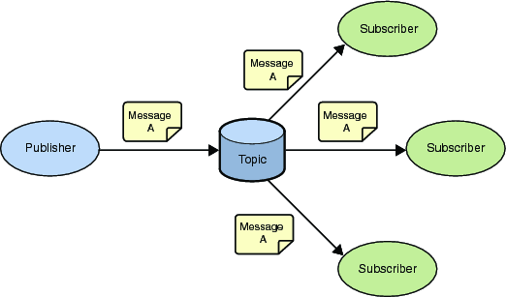
Publish-Subscribe model
Subscribers register to receive specific messages
Publishers maintain a subscription list and broadcast messages to subscribers
Notes:
Subscribers: will register
Publisher: broadcast message to all Subscribers.. And only intended subscriber will respond based on frequency.. Like phone calls
One to One Or
One to many

Slide 26
Publish-Subscribe model
  Pros
  Changeability: Since publishers are loosely coupled to subscribers.
  Scalability: Easy to plug-in new subscribers/publishers without affecting the rest of the system
  Performance: through parallel communication to subscribers
  Cons
  Reliability: Does not guarantee delivery of messages
  Testing: Difficult to test and debug the system since it is hard to predict and verify responses and the order of responses.
    no control over the order of computations of subscribers
Notes:
Reliability: in one to many broadcasting there is not guarantee delivery of messages

Slide 27
Service-Oriented Architecture (SOA)
A Service Oriented Architecture (SOA) starts with a businesses process.
In this context, a service is a business functionality that is well-defined, self-contained, independent from other services, and published and available to be used via a standard programming interface.
Software manages business processes through a SOA with well-defined and standard interfaces that can build, enhance, and expand their existing infrastructure more flexible.
Notes:
For example: apple each year make versions based on business functionality

Slide 28
SOA services can be extensively reused within a given domain or product line, and even among legacy systems.
Loose coupling of service–orientation provide great flexibility for enterprises to make use of all available service recourses regardless of platform and technology restrictions.
The connections between services are conducted by common and universal message oriented protocols such as the SOAP Web service protocol, which can deliver requests and responses between services loosely.
A connection can be established statically or dynamically.
Notes:
Regardless of any restictions
Basically to provide services

Slide 29
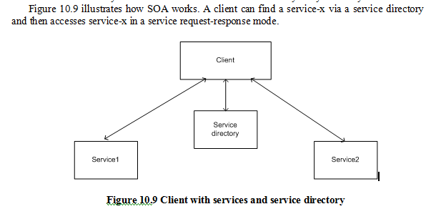
Notes:
Request is send by client…If the service is available ..the respond will be send by the service

Slide 30
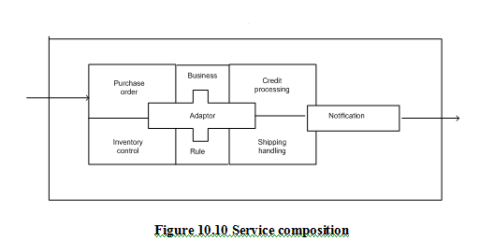
Notes:
Loose coupling
Based on business needs this architecture is designed

Slide 31
Advantages of SOA:
Loosely-coupled connection: Loose-coupling is the key attribute of SOA.
Each service component is independent from other services due to the stateless service feature.
The implementation of a service will not affect the application of the service as long as the exposed interface is not changed.
It makes SOA software much easier to evolve and update.
Notes:
Loose-coupling is the main
easier to evolve which is the meaning of loose coupling

Slide 32
Interoperability: Technically any client or any service can access other services regardless of their platform, technology, vendors, or language implementations.
Reusability: Any service can be reused by any other service,. Because clients of a service only need to know its public interfaces, service composition and integration become much easier.
SOA based business application development comes much more efficient in term of time and cost.
Notes:
No restriction for the service
SOA is better than all prv architectures

Slide 33
Scalability: Loosely coupled services make themselves easy to scale.
The coarse-grained, document-oriented, and asynchronous service features enhance the scalability attribute.

Slide 34
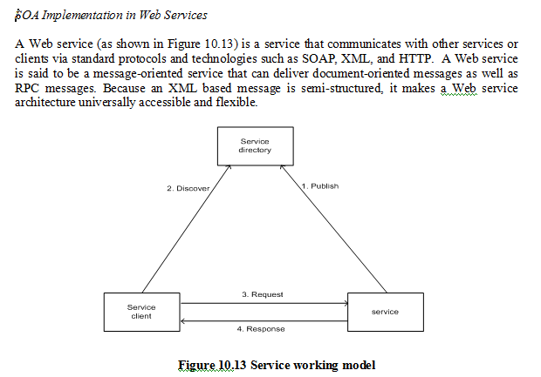
Notes:
Service directory: like the lookup table (like mobily or stc)
Service : email is a service (like phone call)

Slide 35
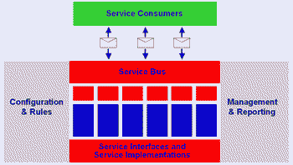
Implementation of SOA Architecture

Slide 36
To implement SOA, enterprises need a service architecture, Figure Shows several services
consumers can invoke services by sending messages.
These messages are typically transformed and routed by a service bus to an appropriate service implementation.
This service architecture can provide a business rules engine that allows business rules to be incorporated in a service or across services.

Slide 37
The service architecture also provides a service management infrastructure that manages services and activities like auditing, billing, and logging.
In addition, the architecture offers enterprises the flexibility of having agile business processes, better addresses the regulatory requirements like Sarbanes Oxley (SOX), and changes individual services without affecting other services.
Notes:
Changes can be done without effecting other services

Slide 38
Development Architecture

Slide 39
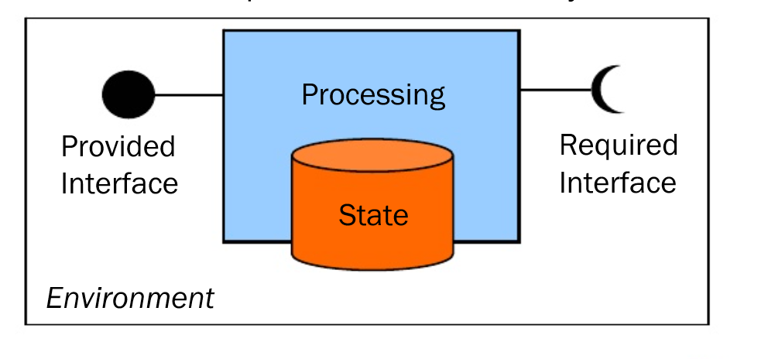
Component

Slide 40
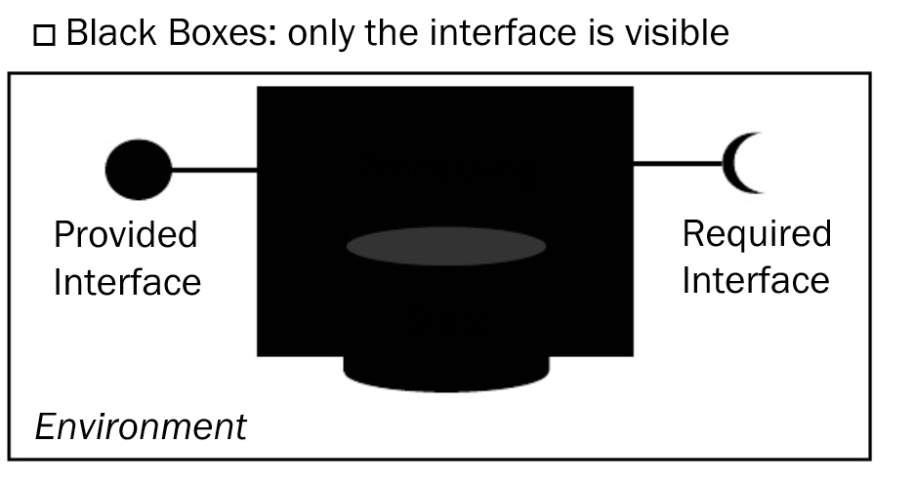
Component
Notes:
Interface is provided but other internally is hidden- components are hidden –black box
Example: banking process.. Only interface and required are provided but other processing are hidden

Slide 41
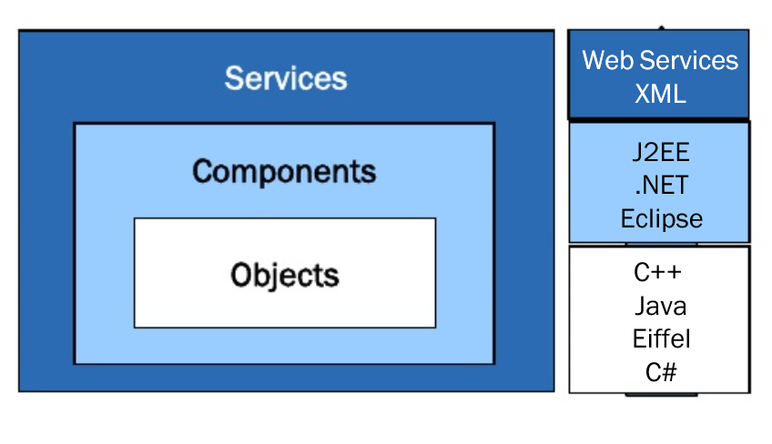
Relation between Object, Component & Service
Notes:
Example of services: web services, xml
Example of components: .NET…

Slide 42
Component Oriented Architecture
Notes:
Example: paying fees for conference registration
Description for this will be provided later..

Slide 43
Component Vs Object Oriented Architecture
Component | Object
Encapsulates State and functionality | Encapsulates State and functionality
Unit of Composition | Unit of Instantiation
Well defined interfaces with dependencies | May not always provide interfaces
Can be deployed in nodes and utilized | During runtime they move between components
Notes:
Difference:

Slide 44
Component Vs Service Oriented Architecture
Component | Service
Component providers charge on per-deployment basis | Service provider charge on per-call basis
Component can be distributed | Service can be made available and
Component should be deployed and used | Services are published and advertised
Compatibility is a problem | Interoperable through standard protocols
Notes:
Component providers charge on per-deployment basis – for example download matlab
Service provider charge on per-call basis- service for one hour for example

Slide 45
Object Oriented Vs Component Vs Service

Slide 46
Map-Reduce Pattern
Context: Businesses have a pressing need to quickly analyze enormous volumes of data they generate or access, at petabyte scale.
Problem: For many applications with ultra-large data sets, involves sorting the data and then analyzing the grouped data efficiently in a distributed and parallel environment.
Solution: The map-reduce pattern requires three parts:
  A specialized infrastructure takes care of allocating software to the hardware nodes in a massively parallel computing environment and handles sorting the data as needed.
  A programmer specified component called the map which filters the data to retrieve those items to be combined.
  A programmer specified component called reduce which combines the results of the map
Notes:
This is new architecture … developed because of big data
For example twitter..
Problem: data accidents.. We need to analyze the data, extracted and processed efficiently

Slide 47
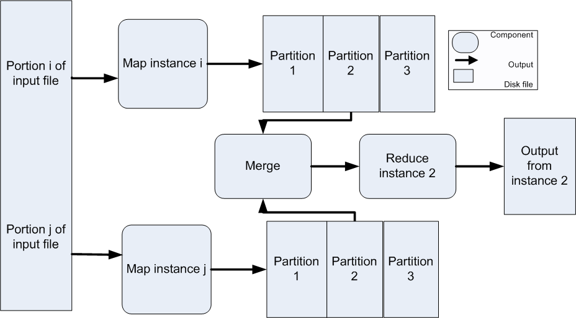
Map-Reduce Example
Notes:
Mapper: filters the data
Reducer: combine the results from mapper

